Slide 1

Kazakh, Turkish, Russian and English multilinguals: vocabulary knowledge in structural different languages
Dr Michael Daller
University of Reading, UK
Nazarbayev University
29 November 2018

Slide 2
Outline of the presentation
Theoretical background:
The bilingual advantage/ disadvantage (Total Conceptual Vocabulary (TCV); non-verbal cognitive advantages/disadvantages)
Study 1 (Turkish/ English bilingual children in the UK)
2. The Common Underlying Proficiency in Bilinguals (CUP) versus the Cognate Effect hypothesis
Study 1 (Turkish/ English bilingual children in the UK)
Study 2 (Kazakh/Russian/English multilinguals in Kazakhstan)
3. Conclusions and areas for further research

Slide 3
Theoretical Background 1
The bilingual advantage/ disadvantage (Total Conceptual Vocabulary (TCV); non-verbal cognitive advantages/disadvantages)
Many studies show that bilinguals have a smaller vocabulary when compared with monolinguals, but this is not the case when the TCV is taken into account (e.g. Pearson, Fernández & Oller 1993)
Some studies show that bilinguals have cognitive advantages even in non-verbal IQ scores over monolinguals (Bialystok, & Viswanathan, 2009; for an overview see Daller and Ongun 2017)

Slide 4
Theoretical Background 2
The Common Underlying Proficiency in Bilinguals (CUP) versus the Cognate Effect hypothesis

Slide 5
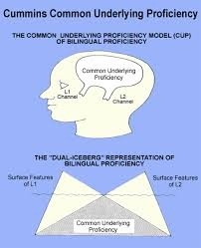
Theoretical background 2 CUP
Common Underlying Proficiency, CUP (Cummins,1980)
There is a common area beneath the icebergs used for both languages, it is a central operating system in which bilinguals can transfer their existing L1 knowledge and apply it to their L2.
The Developmental Interdependence Hypothesis(Cummins,1979)
Based on the relationship between the development of L1 and L2.
Competence in L2 depends in part on the level of competence already acquired in L1.
High level L1 competence development involves similar development of L2 skills.

Slide 6

Theoretical background 2
The Cognate Effect
l
Cognates (word that are (almost) similar
between languages facilitate learning,
e.g. Costa et al. 2000)
Examples:
English: Crocodile = Russian: крокодил (krokadil)
versus Kazakh: қолтырау (qoltıraw)
English: exam = Russian: Экзамен
versus Kazakh: мтихан

Slide 7
Research question 1
Is there a bilingual advantage/ disadvantage for vocabulary ?
Is there a bilingual advantage / disadvantage for non-verbal intelligence ?

Slide 8
Research Question 2
Is there a relation between the vocabulary size in the two or more languages of a multilingual? Is it because of the:
  Common Underlying Proficiency (CUP)
  The Cognate Effect ?

Slide 9
Measures used in study 1 and/or study 2
Vocabulary tests (receptive and productive)
Questionnaires about language use at home
Non-verbal IQ tests

Slide 10
Vocabulary tests with very infrequent words
Sigma 5 (an example for a vocabulary test; not used in this study)
Typically my students (native speakers) know only 50% of the words.
If your native language is a Germanic one and you have a good knowledge of Romance language, almost 100% of the words are known as they are cognates in either of these languages

Slide 11
Try it out
Which words do you understand and are they cognates in any of your languages?

Slide 12
BNC frequencies Sigma V5
1k: budget
2k: attempt equip focus implicate
3k: symbol
4k: illusion
5k: accrue degrade succumb
6k: apathetic vigilant
7k: acclaim exacerbate protocol
8k: augment mumble spindle transient wharf
9k: austere autonomy
10k: deity
11k: assiduous exonerate facade gaudy juxtapose mesmerize surreptitious
12k : epitome erudite insipid
13k: anachronism maelstrom phlegmatic rejoinder voracious
14k: etymology feign
15k: effrontery germane vacillate
16k: antediluvian
17k: hirsute
Beyond 20 k: prestidigitation

Slide 13
The X-lex format
5 x 20 real words with decreasing frequency
20 non-words that are plausible
Scoring:
50 points for every accepted real word
250 for every accepted non-word
Maximum score 5000, Minimum score (theoretical) – 500
Random choice (if an ape does it): Zero

Slide 14
English receptive task – X-lex
that | both | cliff | sandy | lessen | darrock
with | century | stream | military | oak | waygood
before | cup | normal | impress | antique | kennard
person | discuss | everywhere | staircase | chart | gazard
feel | park | deny | daily | limp | fishlock
round | path | shot | essential | permission | cantileen
early | tower | refer | associate | headlong | gillen
table | weather | independent | conduct | violent | pardoe
question | wheel | feeling | relative | fade | frequid
effect | whole | bullet | upward | rake | hobrow
market | perform | juice | publish | trunk | candlin
woman | pity | nod | insult | mercy | litholect
stand | probable | gentle | cardboard | anxious | gumm
believe | signal | slip | humble | pedestrian | alden
fine | dish | diamond | contract | arrow | treadaway
instead | earn | press | mount | feeble | sumption
produce | sweat | provide | tube | sorrow | horozone
group | trick | drum | moreover | brighten | hyslop
arrive | manage | reasonable | crisis | dam | manomize
difficult | mud | boil | jug | outlet | horobin

Slide 15
ve | yumurta | dikkatli | mısır | kıvılcım | saneli
çocuk | kemik | utanmak | posta | üçgen | bilik
iç | iş | bal | tatmak | yazlık | selul
yine | kapalı | halı | yanık | unutma | kuveli
işte | dikmek | misafir | heyecanlı | nazar | ültemek
ayak | komşu | elma | kemer | kayak | menilmek
deniz | bayram | uzay | saçlı | bulma | sorkın
dinlemek | patlamak | patates | zayıflamak | kek | foluk
dışarı | gül | üzüntü | bahane | sıcak olmak | fızlamak
yanlış | mevsim | vapur | fena | şahsen | üsli
kelime | gölge | sevilmek | gergin | devretmek | ansen
kesmek | yangın | pilav | haşlanmak | muhalif | tillemek
uyumak | kavga | pembe | uyanık | ayıklamak | fıta
mektup | lezzet | yüzük | boyamak | ilerleme | araka
top | yıkanmak | kirli | katılma | şirin | küne
otobüs | oyuncak | olur | haberci | mağara | serün
yeşil | zararlı | yavaşça | kova | nişan | valı
burun | dilim | çatal | yazdırmak | uçuş | selmek
yıldız | gözlük | şapka | kase | gereklilik | tulalı
çay | düğme | soyunmak | ilkbahar | iletken | bellime

Slide 16
Vocabulary test in Russian
X-lex format

Slide 17
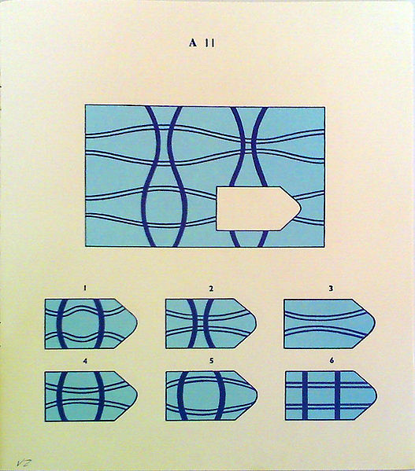
A Measure of Non-verbal IQ scores:
Raven’s Coloured Progressive Matrices

Slide 18
Study 1
Participants
100 Turkish-English bilingual children (all born in the UK, age range 7 - 11)
and their parents (immigrants from Turkey)
Middle class (at least one parent has a university degree)
Measures
Receptive vocabulary tests in both languages (X-lex)
Productive vocabulary tests in both languages (semantic fluency test: cloths, colours, food, body parts)
A non-verbal intelligence test (Raven’s matrices, 1997)
The Language Dominance Scale (Dunn and Fox Tree, 2009)
Language, Social and Background Questionnaire (Luk and Bialystok, 2013)

Slide 19
Research question 1
Is there a bilingual advantage for:
vocabulary
non-verbal IQ?

Slide 20
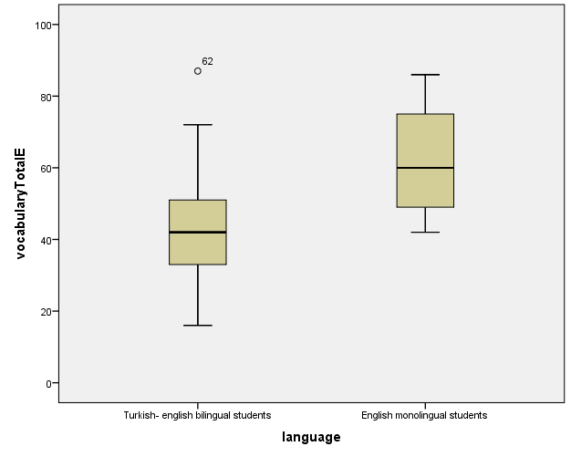
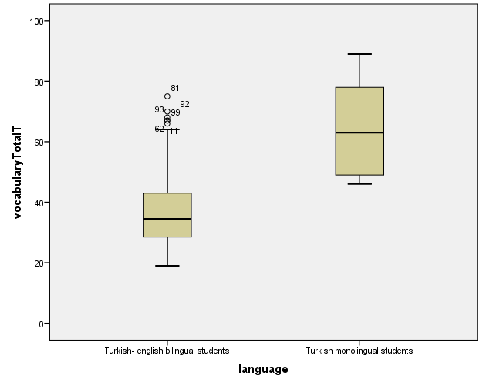
The bilingual vocabulary gap
Productive vocabulary in English
Productive vocabulary in Turkish

Slide 21
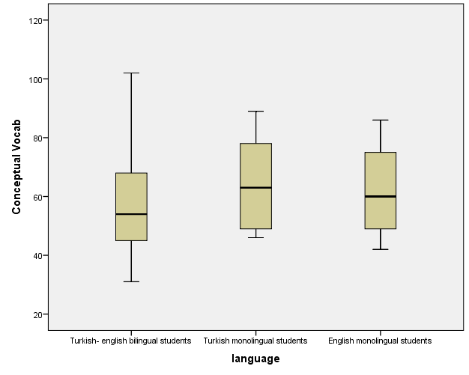
Total Conceptual Vocabulary (productive)

Slide 22
There is no bilingual gap if we compare the total conceptual vocabulary

Slide 23
Is there a cognitive advantage/disadvantage (Raven’s matrices)?
First result: no
All groups score on a similar level with no significant differences
Further analysis: take the language use at home into account (one group of bilinguals that use more Turkish, the other that use more English)

Slide 24
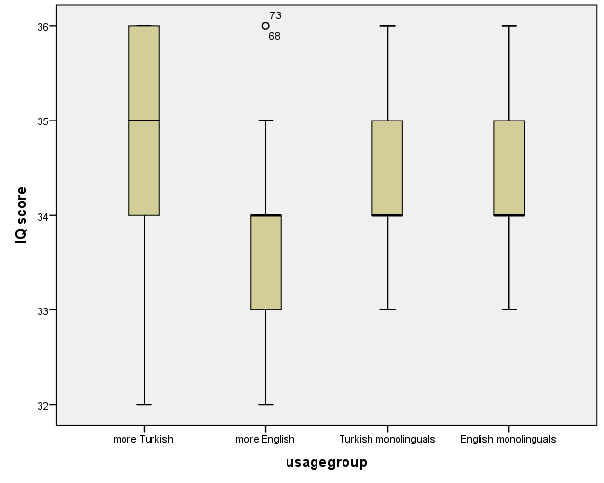
Language use and non-verbal IQ scores

Slide 25
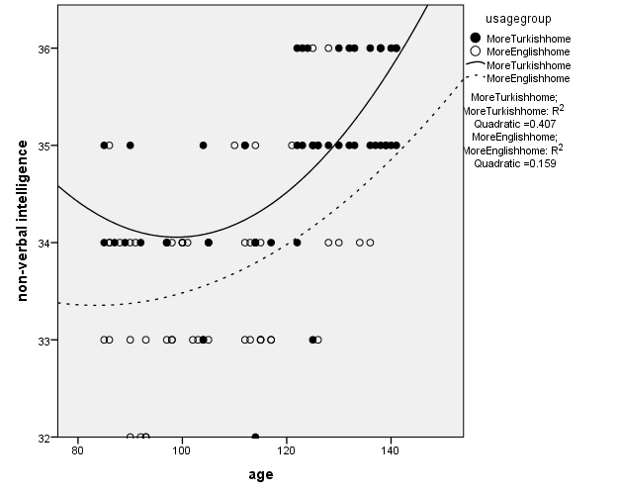
The development of bilingual cognition (IQ scores)

Slide 26
Research Question 2
If the languages of a multilingual are related, is it because of the Common Underlying Proficiency or because of Cognates ?
Two studies:
Turkish-English bilingual children in the UK (study 1)
Kazakh, Russian and English multilinguals (study 2)

Slide 27
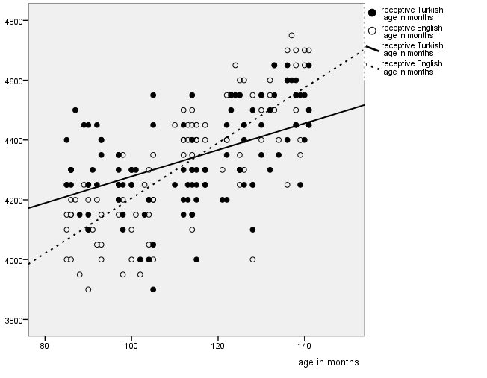
Study 1 (Common Underlying Proficiency)

Slide 28

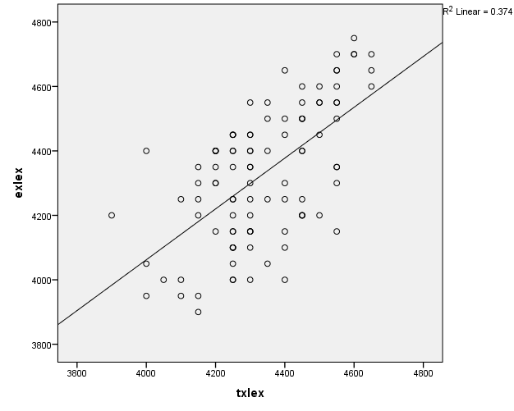

Slide 29
RESULTS Study 1
There is a strong positive correlation between receptive vocabulary of the bilingual children in both languages.
This supports the hypothesis that there is a Common Underlying Proficiency (CUP) in bilinguals even if the languages are typologically different and there are hardly any cognates.

Slide 30
Research question 2: Study 2
How strong is the correlation between the vocabulary knowledge of multilinguals between:
Kazakh and Russian > support for the Common Underlying Proficiency Theory ?
Kazakh and English > support for the Cognitive Effect Theory ?

Slide 31
Study 2: Kazakh, Russian and English multilinguals
Pariticipants:
30 students of the Nazarbayev Intellectual School (Semey)
Measures:
Vocabulary tests in Russian and English and in Kazakh (receptive vocabulary, X-lex format)

Slide 32
Vocabulary size (receptive) in Kazakh and Russian

Slide 33
There is an overlap of 50% between Russian and English vocabulary kowledge

Slide 34
Correlation between the vocabulary sizes in Kazakh, Russian and English (n = 30)
** Significant at the .01 level
 | Kazakh | Russian | English
Kazakh | - | .012 | .016
Russian |  | - | .705**
English |  |  | -
CUP: no
Cognates: yes

Slide 35
Results Questions 1
There is no bilingual disadvantage if the Total Conceptual Vocabulary is taken into account
There is a bilingual cognitive advantage for children that use their L1 (Turkish) more than their L2 (English) at home

Slide 36
Results Question 2
For study 1 (Turkish-English bilingual children in the UK) there is support for the hypotheses on the Common Underlying Proficiency in biliguals.
For study 2 (Trilingual Kazakh-Russian students of English) there is support for the Cognate Effect.

Slide 37
Consequences
Pedagogical Consequences:
Teaching English can use the cognates between Russian and English as a resource
Consequences for Research on Bilingualism:
Does the Common Underlying Hypotheses only hold for children and is it later subsided by the Cognate Effect if a third language is learned.

Slide 38
Conclusions
The results seem to be contradictory, but more research is needed to analyse bilinguals in different settings
Is there a difference between children and young adults?
Does the Cognitive Effect override the effects of the Common Underlying Proficiency Hypothesis?

Slide 39
Further research
Investigating multilinguals with structural different languages is a step forward (so far most studies include only participants with European language, e.g. Spanish/English)
We need more studies with more detailed information about the bilingual history of the participants
We need longitudinal studies

Slide 40
Next steps (Your MA dissertation/ PhD ?)
Develop a Kazakh X-lex test that can be put online and made be available to other researchers
Comparing trilingual children (one group growing up with more Kazakh, one group growing up with more Russian) who learn English in order to support/reject:
the CUP or the Cognate Hypothesis.

Slide 41
Thanks to
Dr Zehra Ongun (Reading University)
Symbat Mazhikov (MA, Reading University) Nazarbayev Intellectual Schools (Semey)
The participants, parents and children of the two studies
and you

Slide 42
References
Bedore, L. M., Peña, E. D., García, M., & Cortez, C. (2005). Conceptual versus monolingual scoring: When does it make a difference?. Language, Speech, and Hearing Services in Schools, 36(3), 188-200.
Bialystok, E., & Viswanathan, M. (2009). Components of executive control with advantages for bilingual children in two cultures. Cognition, 112, 494-500.
Costa, A., Caramazza, A., & Sebastian-Galles, N. (2000). The cognate facilitation effect: implications for models of lexical access. Journal of Experimental Psychology: Learning, Memory, and Cognition, 26(5), 1283.
Cummins,J.(1979). Linguistic interdependence and the educational development of bilingual children. Review of Educational Research,49,222-51.
Cummins,J. (1980). The construct of Language proficiency in bilingual education. In: Colin Baker. Foundation of Bilingual Education and Bilingualism. Clevedon: Multilingual Matters.
Daller, M. & S. Mazhikov (in preparation). Language proficiency in Kazah, Russian and English of multilingual students in Kazahtan.
Daller, M. (in preparation). Vocabulary knowledge of Turkish-German bilingual children. In Bayram, F. (ed.). Turkish heritage speakers in Europe.
Daller, M., & Ongun, Z. (2017). The Threshold Hypothesis revisited: Bilingual lexical knowledge and non-verbal IQ development. International Journal of Bilingualism, 1367006917690835.
Dunn, A. L., & Tree, J. E. F. (2009). A quick, gradient bilingual dominance scale. Bilingualism: Language and Cognition, 12(3), 273-289.
Meara, P., & Milton, J. (2003). X_Lex, the Swansea levels test. Newbury: Express.
Pearson, B. Z., Fernández, S. C., & Oller, D. K. (1993). Lexical development in bilingual infants and toddlers: Comparison to monolingual norms. Language learning, 43(1), 93-120.
Umbel, V. M., Pearson, B. Z., Fernández, M. C., & Oller, D. K. (1992). Measuring bilingual children's receptive vocabularies. Child development, 63(4), 1012-1020.

